Slide 1
CPAD - Chat Room App

Slide 2
Team Details
Team number - 03
Batch - 2YA, 2022
Topic - Chat Room Application
Members:
Rushabh Porwal - 2022SP93034
Prerna Sharma - 2022SP93066
Harshwardhan Chougule - 2022SP93078

Slide 3

Introduction
Welcome to Chat Room App, a revolutionary platform that redefines communication by bridging the gap between familiar faces and new connections. In a world where interactions matter, Chat Room provides a seamless experience for both known and unknown peers.

Slide 4

Key Features
Personalized Avatars
Dynamic Channel Communication
Customized Chat Spaces
User-Friendly Interface
Privacy and Security
Redux State Management

Slide 5



Tech Stack

Slide 6
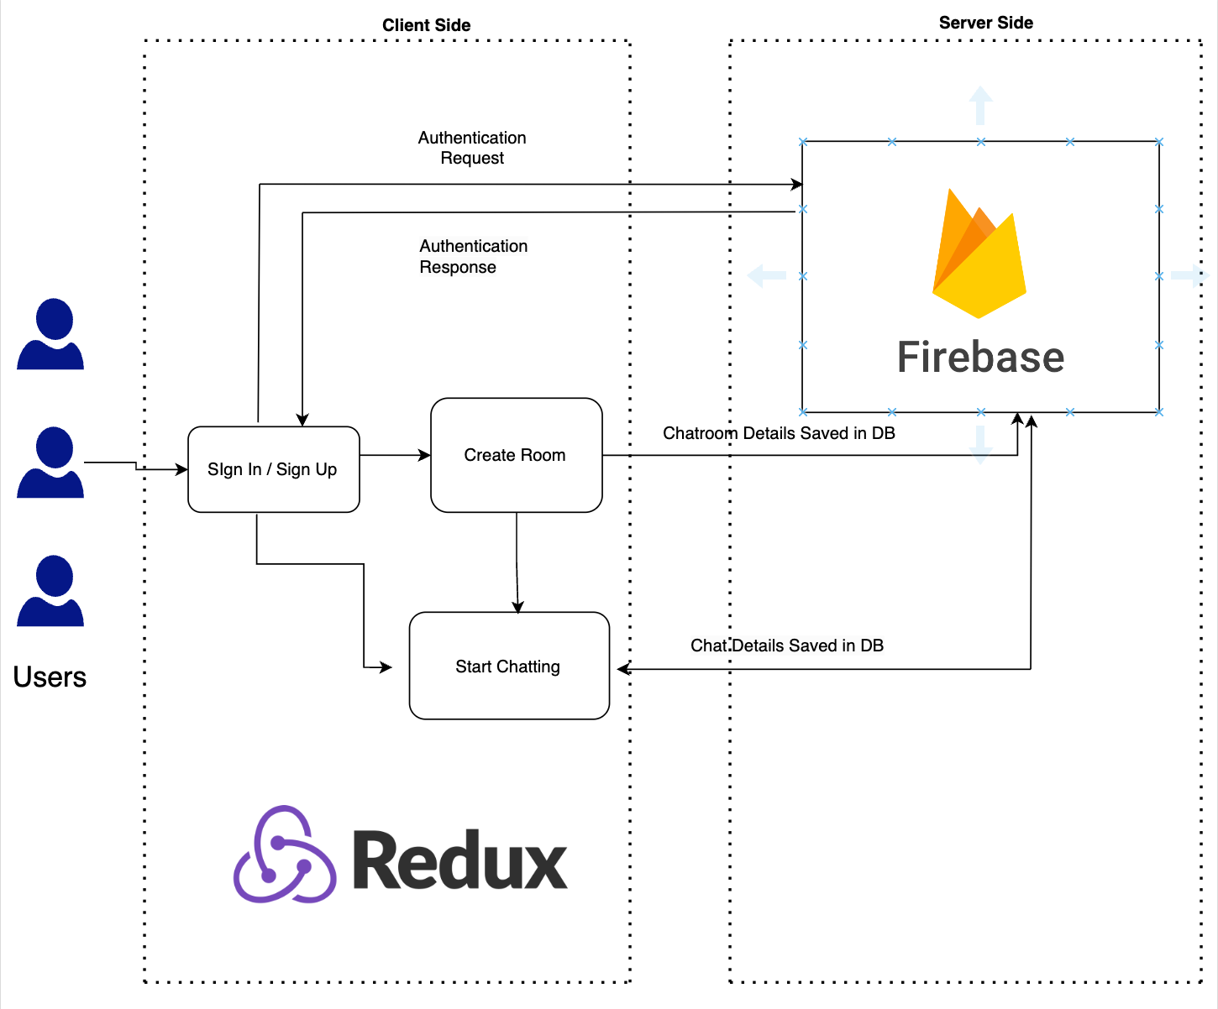
Architecture

Slide 7
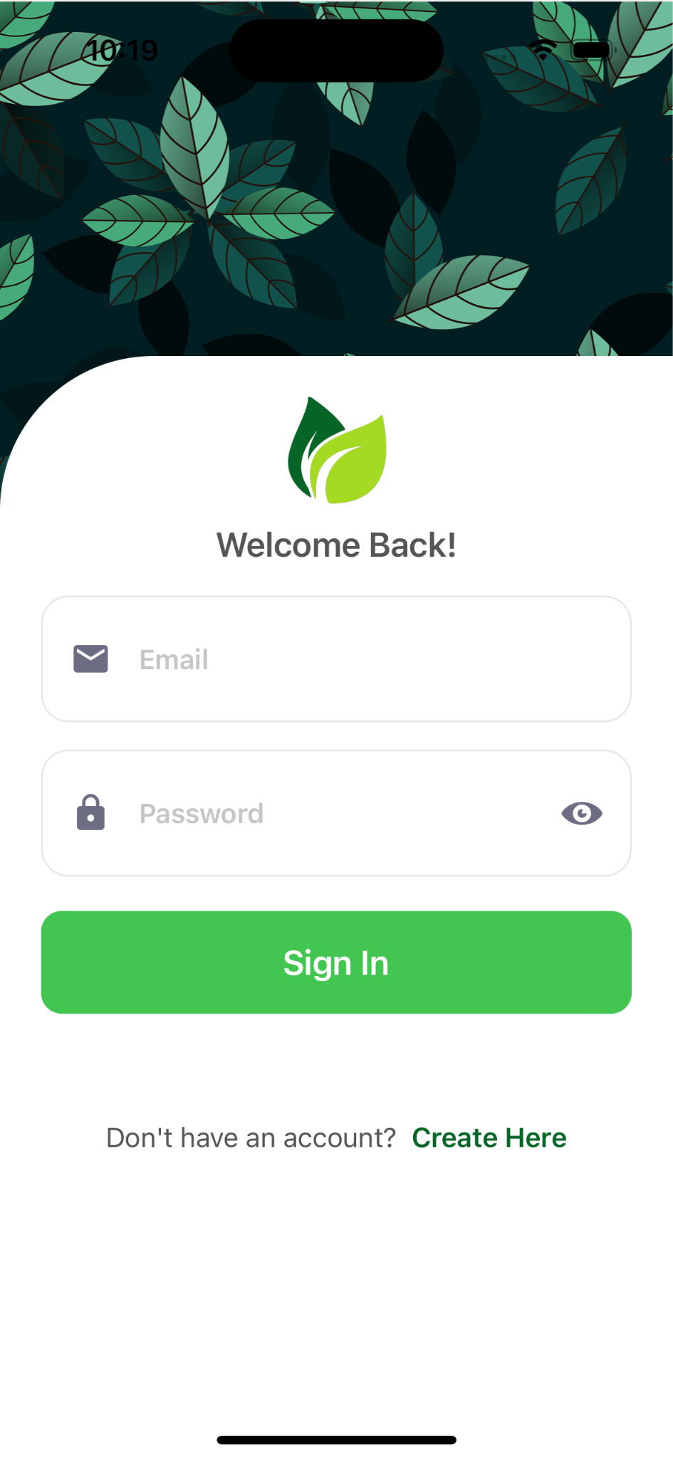
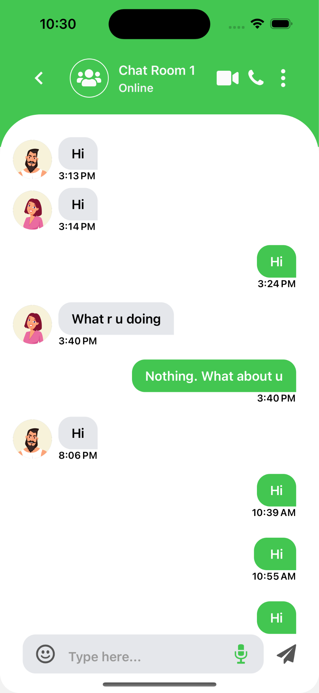
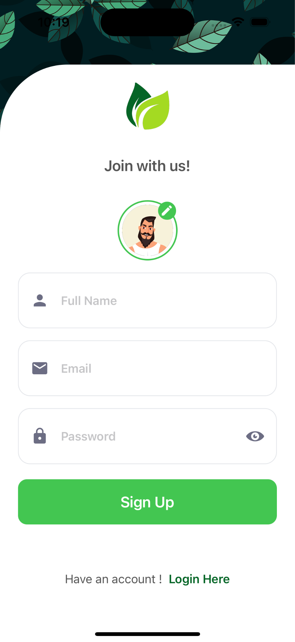
Screenshots

Slide 8
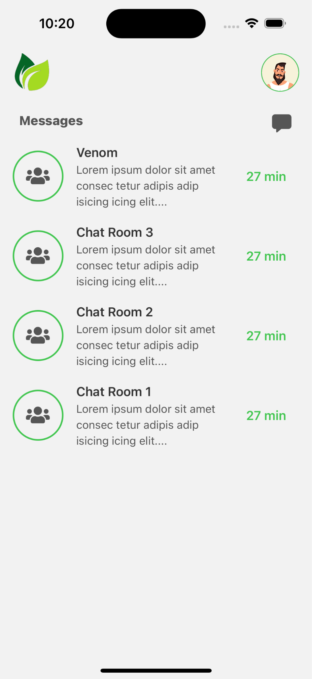
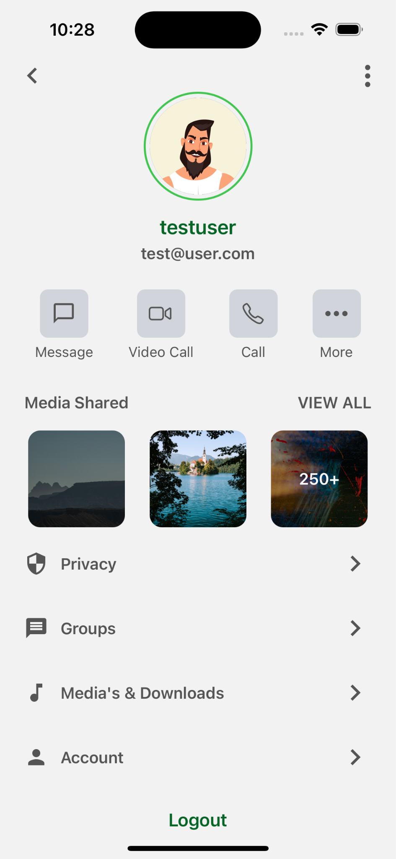
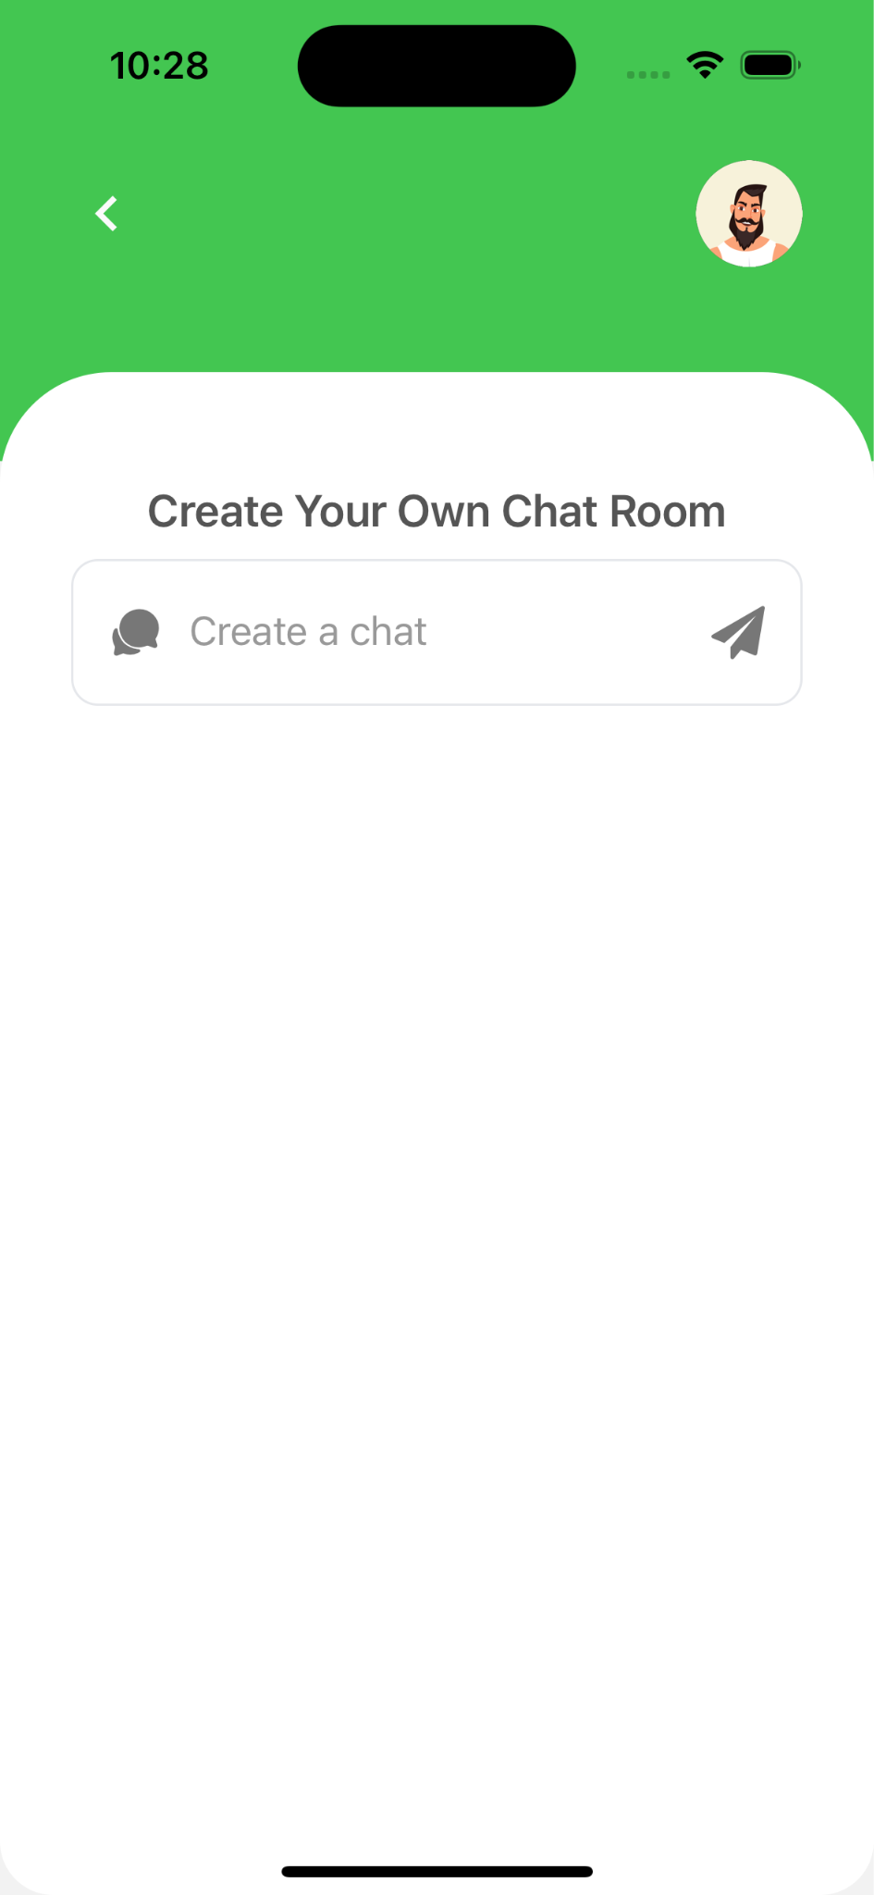
Screenshots

Slide 9

Challenging yet
Interesting Facts
New Technology
Choose from different technologies option.
We made a state management system to store the user credentials when they leave the application.
Used Firebase as BaaS for authentication and as a database.

Slide 10
Future Scope
In the world of innovation, here are some of the points which can be incorporated in coming future to enhance the experience of interaction via our application.
Different types of SignUp Functionality
Media Sharing Capabilities
Group Join Functionalities
oAuth Integration
Integration with ChatGPT
Time Stamped

Slide 11
Thank You!

